Slide 1
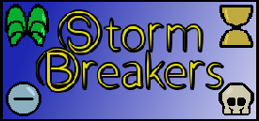
Iteration Report #3

Slide 2
Team Storm
Brett Blackstock - Project Leader, Lead Programmer
Michael Krause - Project Manager, Lead Narrative
Charlie Brown - Narrative / Utility
Wade Hetland - Narrative / Utility
Rachel Groth - Programmer
David Enersen - Lead Artist
Quincton Rush - 2D Artist
Skyler Wittmer - 2D Artist
Garrett Verhoeven - Contract Sound Designer

Slide 3
Audio
Sound effect drafts for:
Normal attack hits
Special attack hits
Blocking
Movement
Basic Fight Song Draft

Slide 4
Programming
Dummy animations
Movement bug fixes
Basic special gauges
Implementing controller input
Flip hitboxes after side changes
Blocking zones and variable damage
Most attacks are implemented

Slide 5
Narrative
Created names for every special move
UI Stuff (Themes our world)

Slide 6
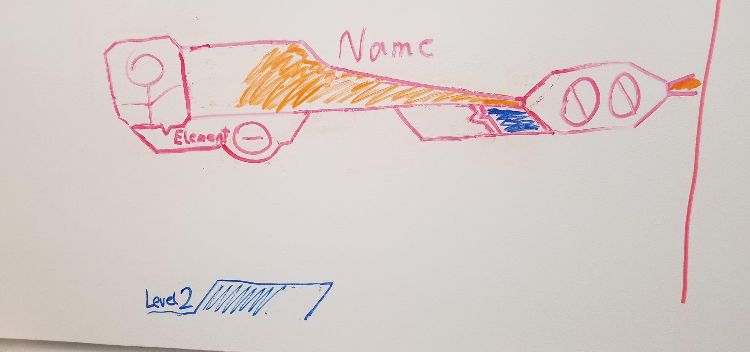
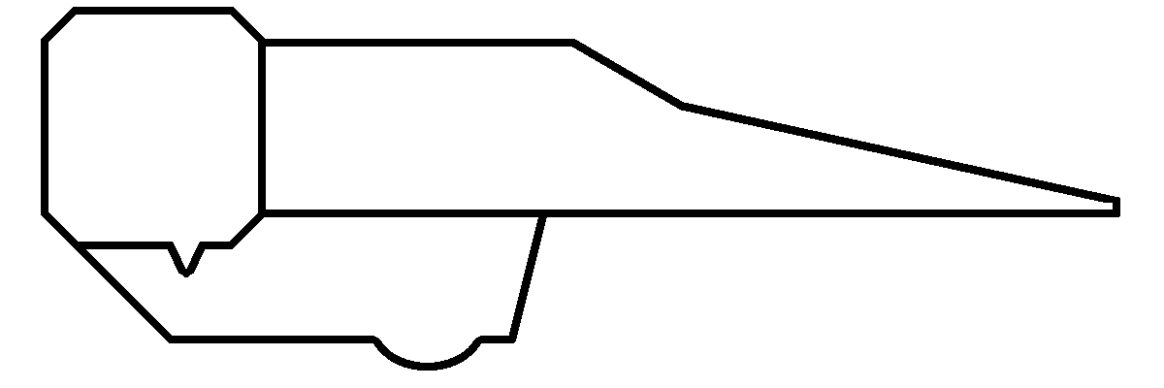


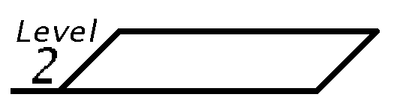
UI
UI theme decided upon
Angular
Battle UI drafted

Slide 7
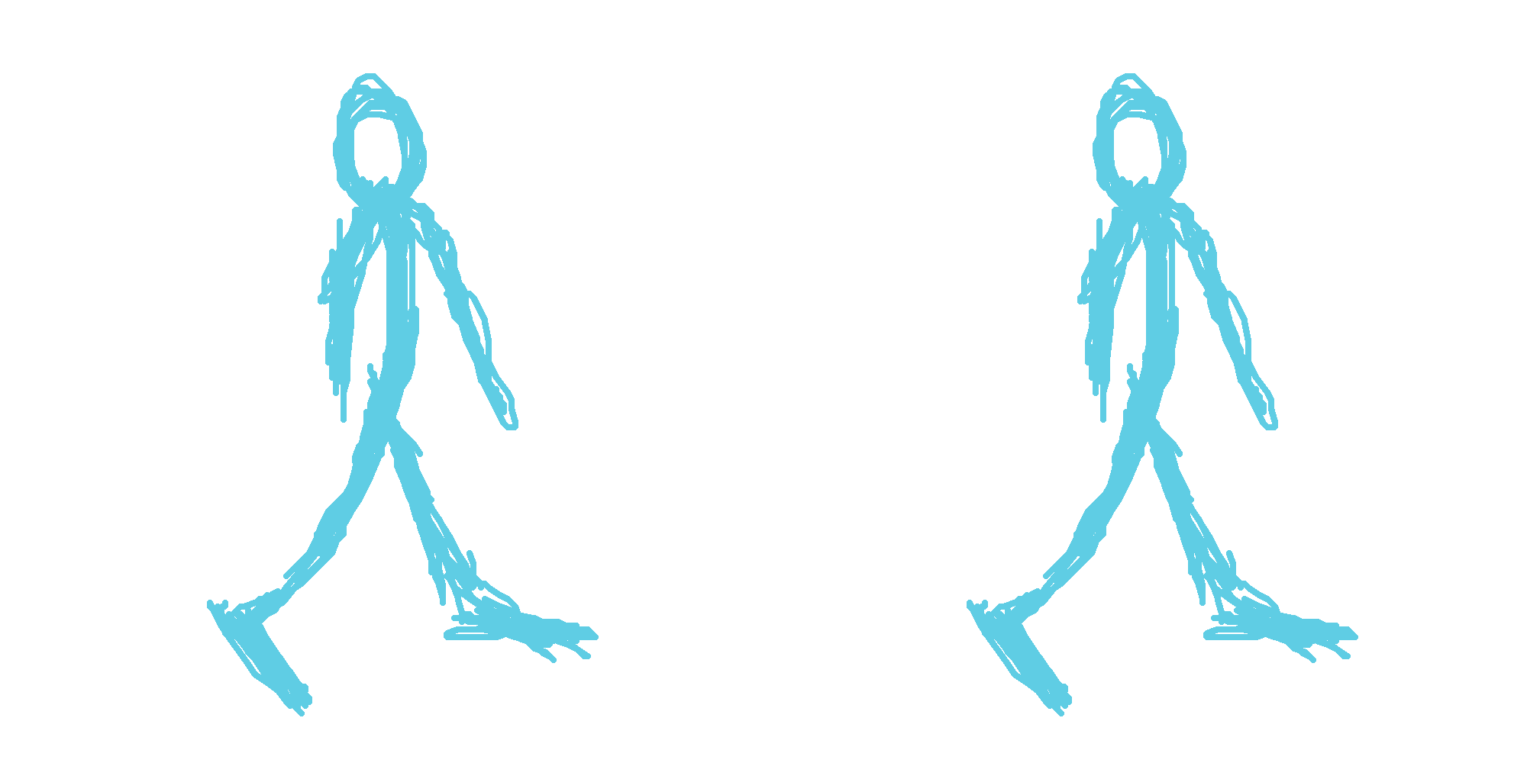
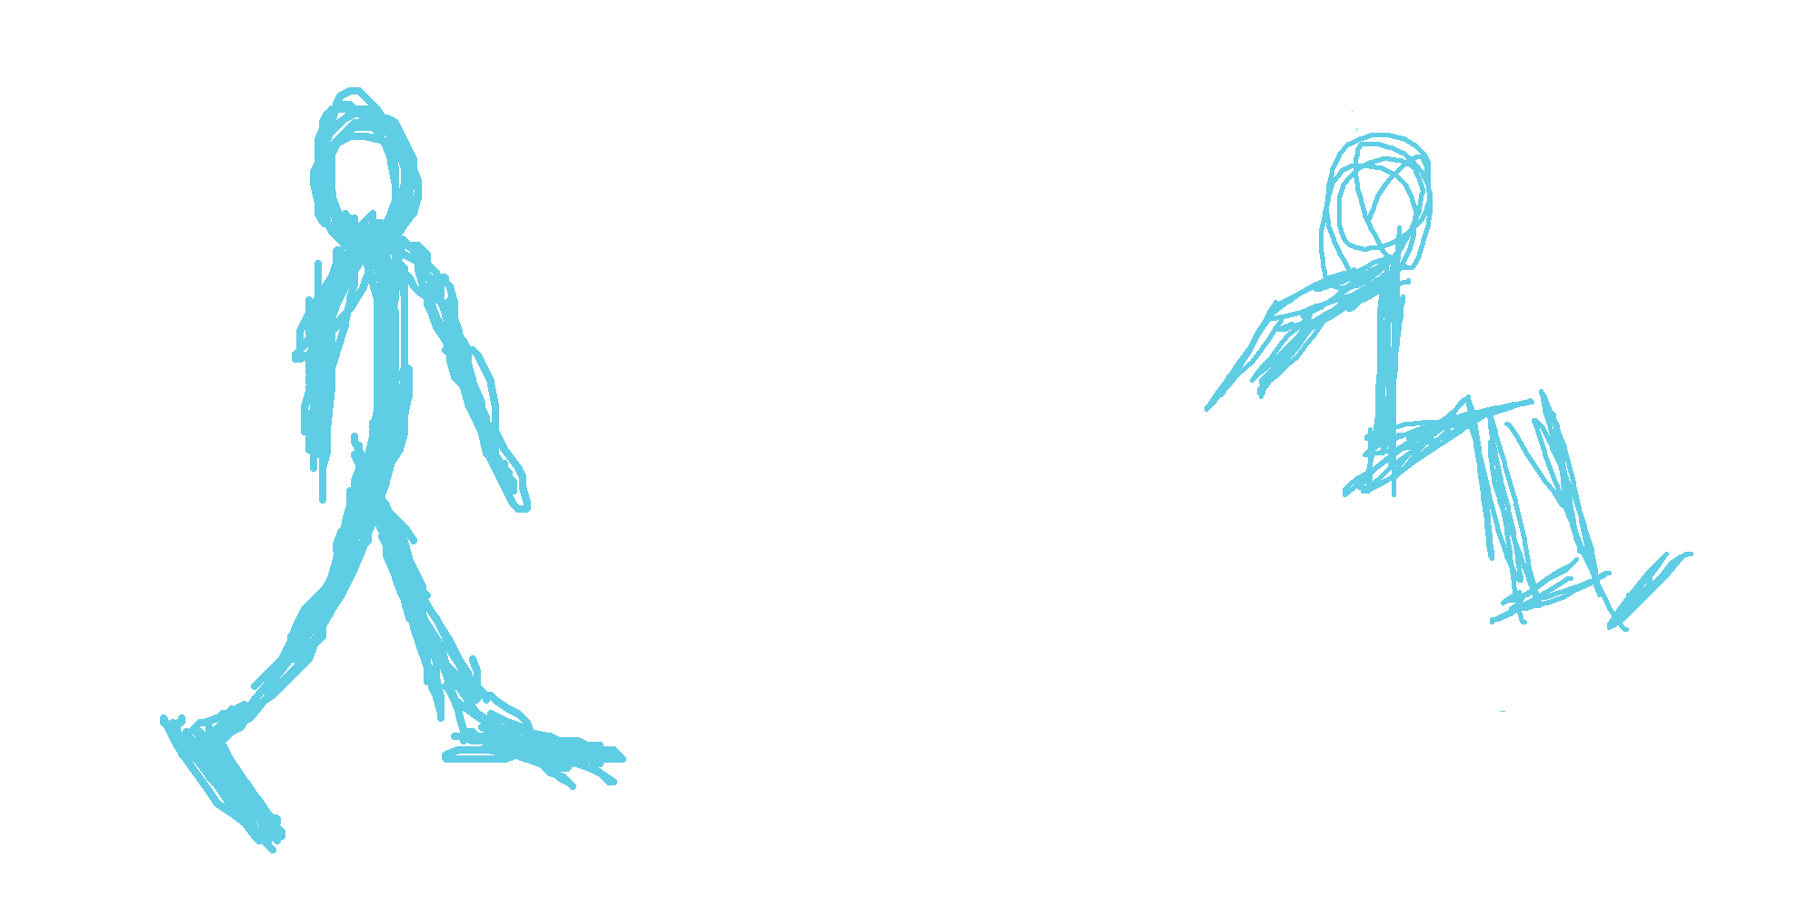
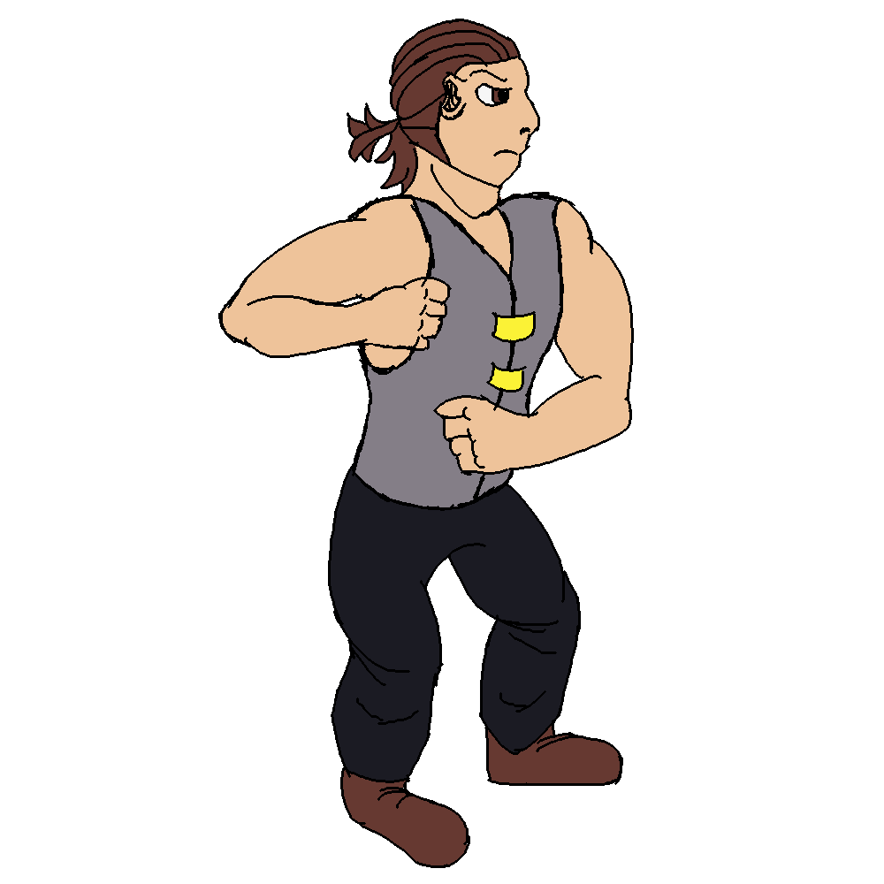
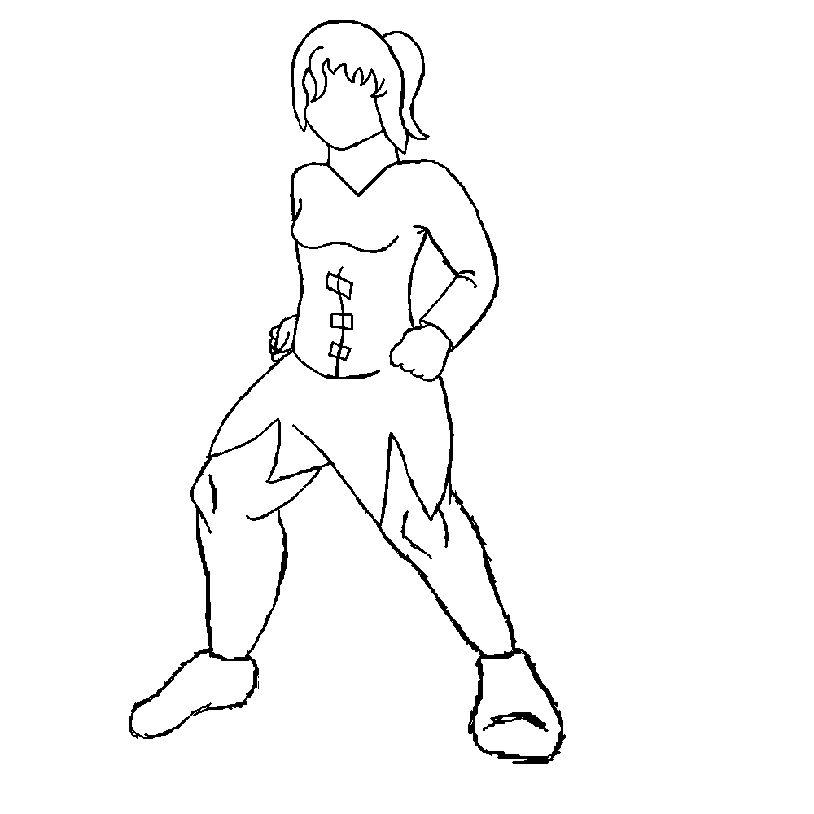
Art
Prototype sprites for Lynne
More detailed idle animations

Slide 8
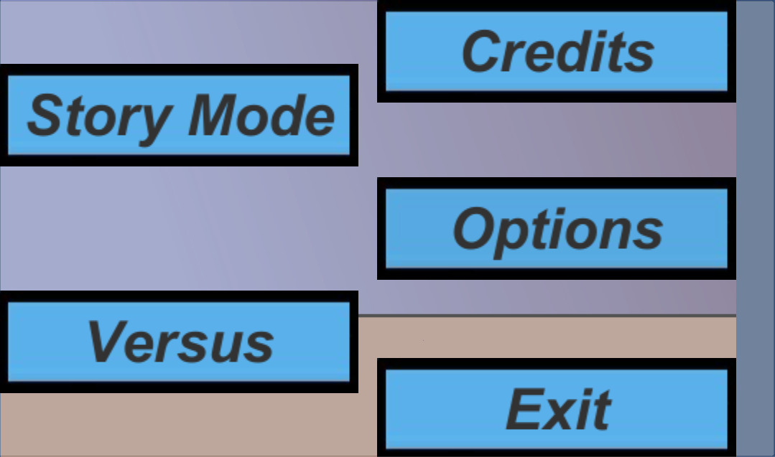
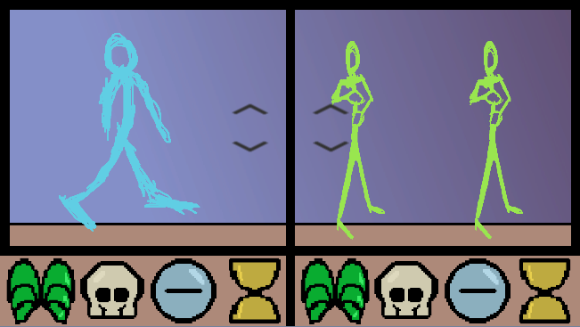
Menus
Prototype Main Menu and Character Select screens
Character choices carry over

Slide 9
Trello Cards
Implement Dummy Animations
Create names for special moves
Implement basic special gauges
Research sound programs to be used for making sound effects
Prototype sprites for all moves (Lynne)
Make Lynne base model sprite
Implement basic Main Menu in Unity
Draft Normal Hit SFX
Draft Block/Armor SFX
Draft Special Attack SFX
Research and implement controller input
2nd Draft of Battle UI
Update background art in the build
Implement basic blocking mechanic in Unity
Flip hitboxes when you change sides
Convert Audacity SFX to .wav
Create Character Select screen prototype in Unity
Unity script chaining scenes

Slide 10
Game Demo

Slide 11
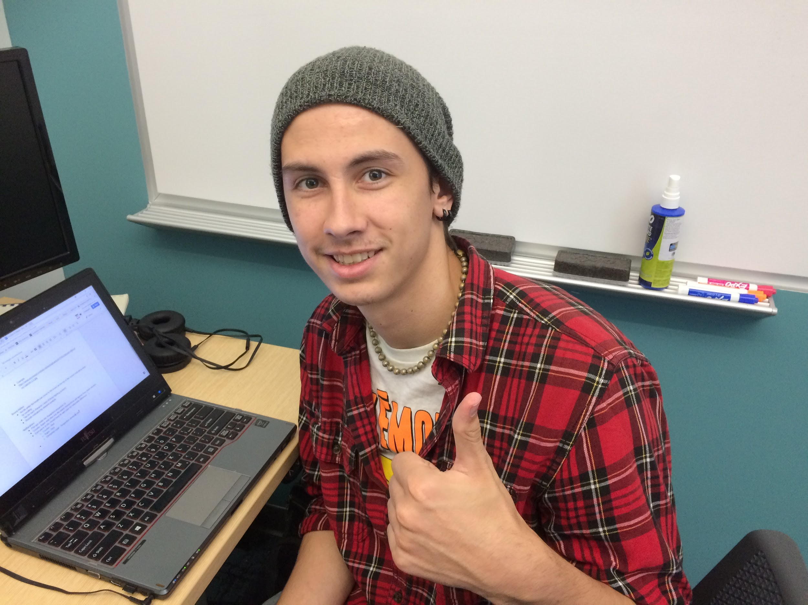
Questions for our good boy?

